Slide 1
AVL Tree
Insertion and deletion

Slide 2
Introduction
AVL trees are self balancing Binary search trees.
Height(N)=Max(Height(LST),Height(RST))+1
Balance Factor = Height(LST)-Height(RST)
Allowed values of BF are –1, 0, and +1.

Slide 3
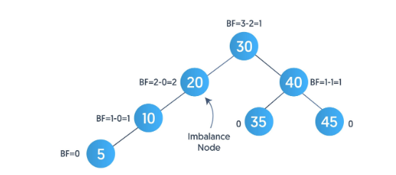
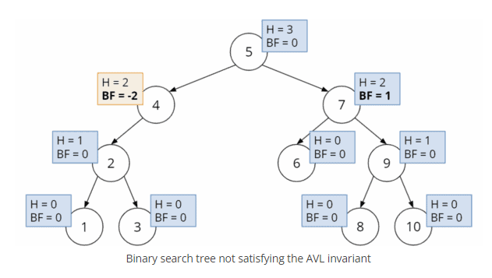
Exercise
Calculate heights and balance factors of the following trees.

Slide 4
Rotations in AVL
Single Rotations:
  Right Rotate
  Left Rotate
Double Rotations
  Left Right Rotation
  Right Left Rotation

Slide 5
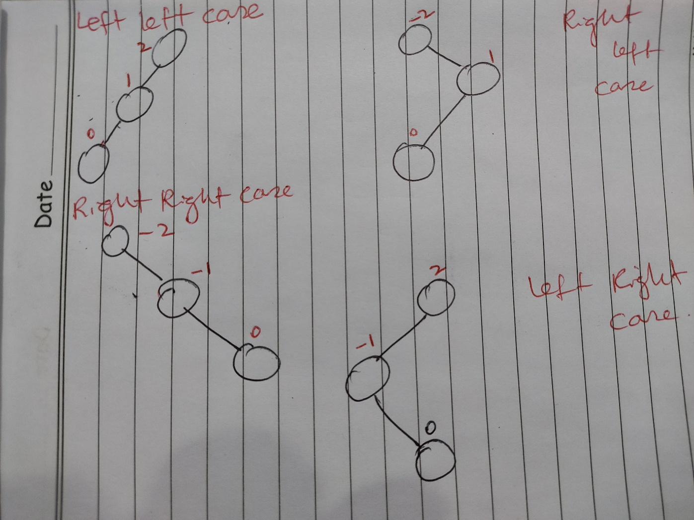
Cases of imbalance
Left left case and right right case are resolved through single right rotation and single left rotation respectively.
Right left case and left right case are resoved through double rotations.

Slide 6
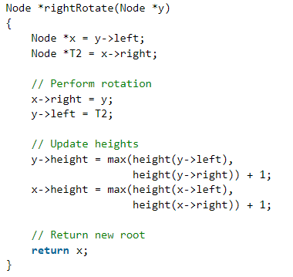
Right rotate

Slide 7
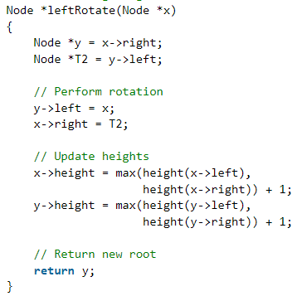
Left Rotate

Slide 8
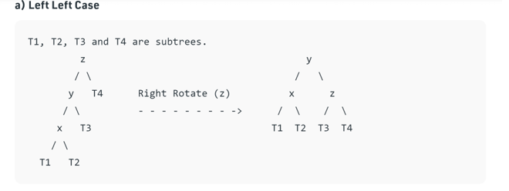
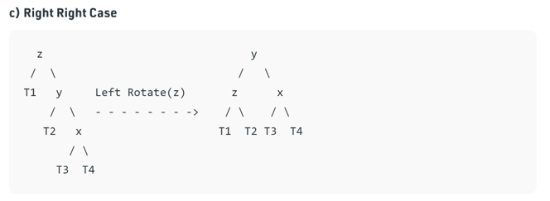

Slide 9
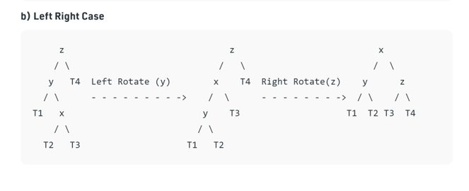
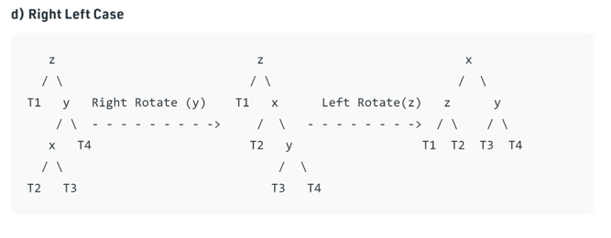

Slide 10
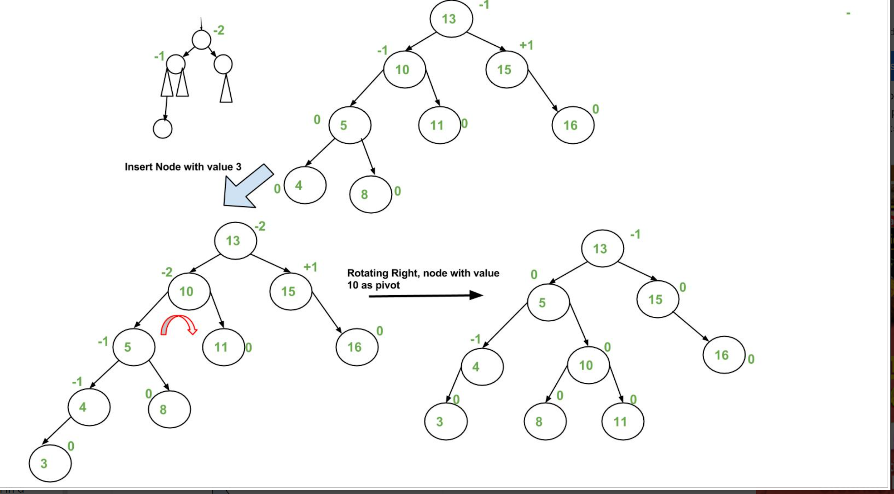
Insertion

Slide 11
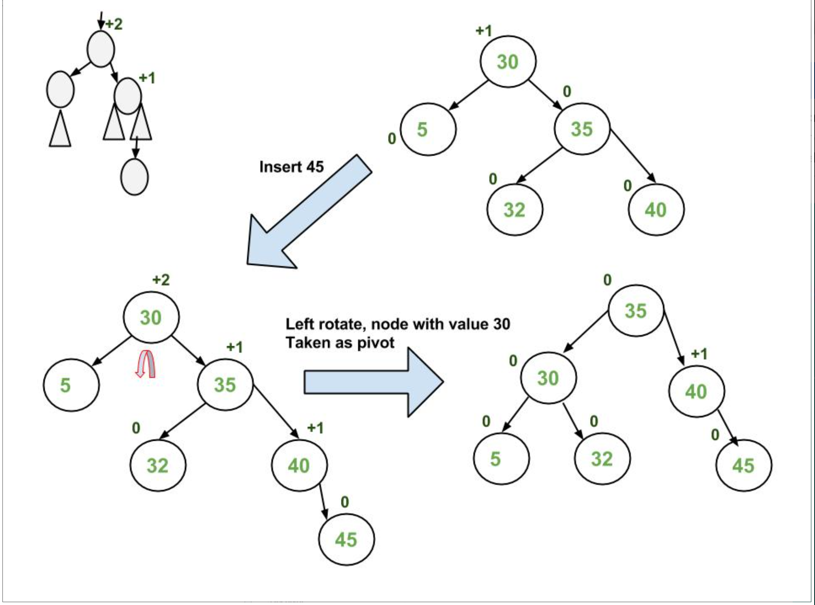

Slide 12
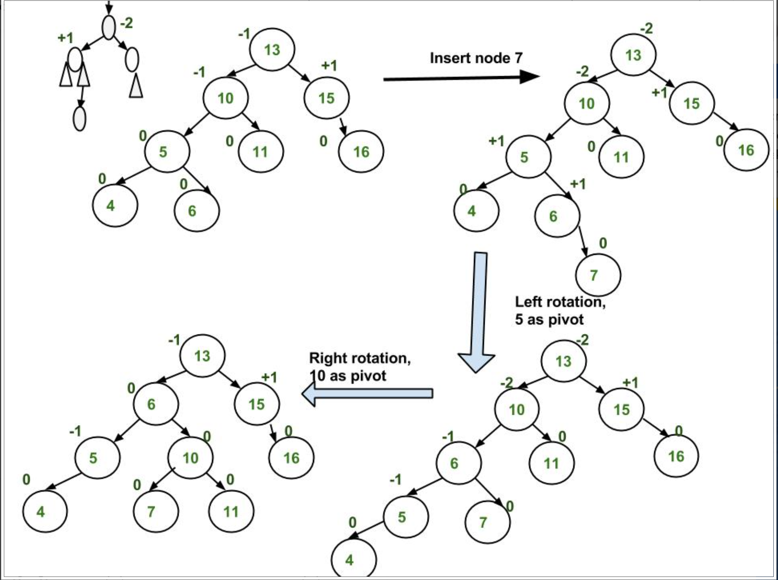

Slide 13
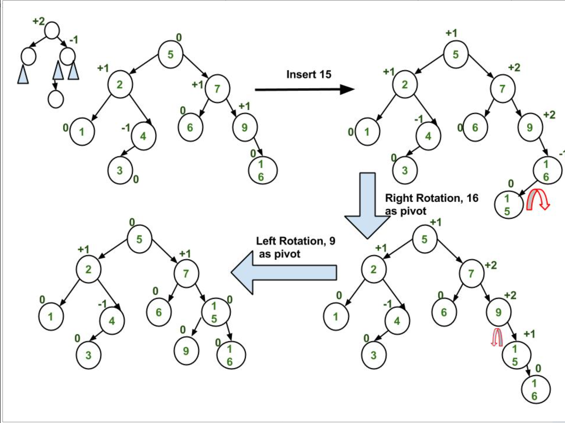

Slide 14
Insertion in AVL Algorithm
In the recursive BST insert, after insertion, we get pointers to all ancestors one by one in a bottom-up manner. So we don’t need parent pointer to travel up. The recursive code itself travels up and visits all the ancestors of the newly inserted node.
1) Perform the normal BST insertion.
2) The current node must be one of the ancestors of the newly inserted node. Update the height of the current node.
3) Get the balance factor (left subtree height – right subtree height) of the current node.
4) If balance factor is greater than 1, then the current node is unbalanced and we are either in Left Left case or left Right case. To check whether it is left left case or not, compare the newly inserted key with the key in left subtree root.
5) If balance factor is less than -1, then the current node is unbalanced and we are either in Right Right case or Right-Left case. To check whether it is Right Right case or not, compare the newly inserted key with the key in right subtree root.

Slide 15
Deletion in AVL Algorithm
Let w be the node to be deleted
1) Perform standard BST delete for w.
2) Starting from w, travel up and find the first unbalanced node. Let z be the first unbalanced node, y be the larger height child of z, and x be the larger height child of y. Note that the definitions of x and y are different from insertion.
3) Re-balance the tree by performing appropriate rotations on the subtree rooted with z. There can be 4 possible cases that needs to be handled as x, y and z can be arranged in 4 ways. Following are the possible 4 arrangements:
a) y is left child of z and x is left child of y (Left Left Case)
b) y is left child of z and x is right child of y (Left Right Case)
c) y is right child of z and x is right child of y (Right Right Case)
d) y is right child of z and x is left child of y (Right Left Case)
Like insertion, following are the operations to be performed in above mentioned 4 cases. Note that, unlike insertion, fixing the node z won’t fix the complete AVL tree. After fixing z, we may have to fix ancestors of z as well

